Slide 1
Combinatorics
Course: Discrete Structures
(Course Code : DJ19CEC303)

Slide 2
Detailed Syllabus: (Unitwise) Unit 3 : Combinatorics
Combinatorics: Mathematical Induction, Basics of counting - Pigeon-hole principle, permutations and combinations, recurrence relations, solving recurrence relations, generating functions.
Probability: Basic probability, conditional probability, Bayes theorem

Slide 3
Permutations

Slide 4
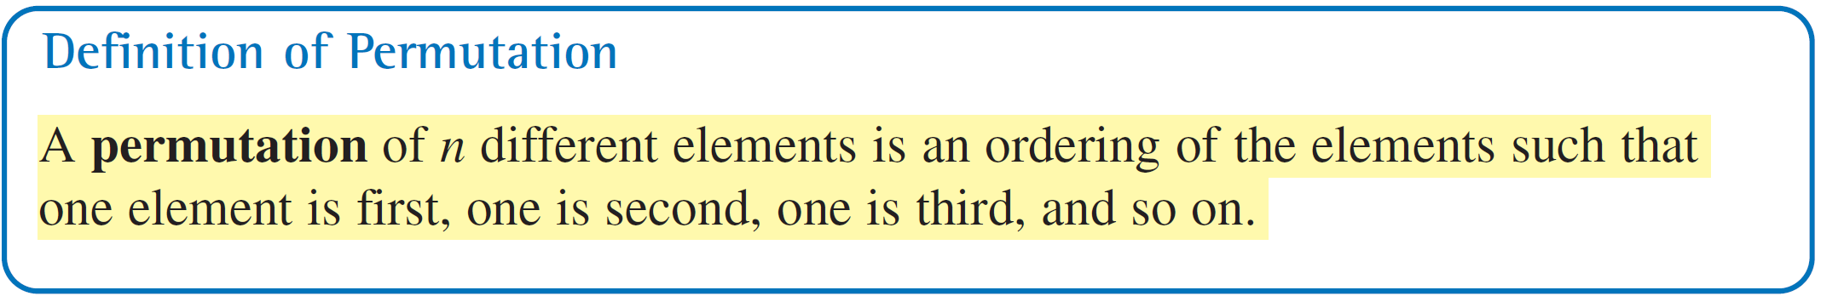
Permutations
One important application of the Fundamental Counting Principle is in determining the number of ways that n elements can be arranged (in order). An ordering of elements is called a permutation of the elements.

Slide 5
Example – Finding the Number of Permutations of n Elements
How many permutations of the following letters are possible?
A B C D E F
Solution:
Consider the following reasoning.
First position: Any of the six letters
Second position: Any of the remaining five letters
Third position: Any of the remaining four letters
Fourth position: Any of the remaining three letters
Fifth position: Either of the remaining two letters
Sixth position: The one remaining letter

Slide 6
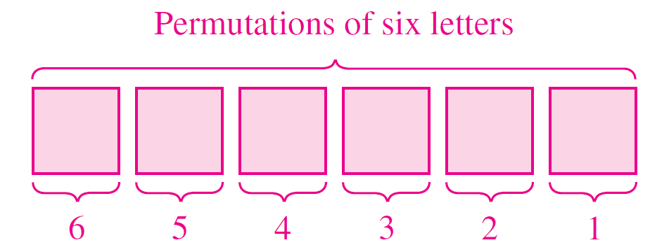
Example – Solution
cont’d
So, the numbers of choices for the six positions are as follows.
The total number of permutations of the six letters is
6! = 6  5  4  3  2  1 = 720.

Slide 7
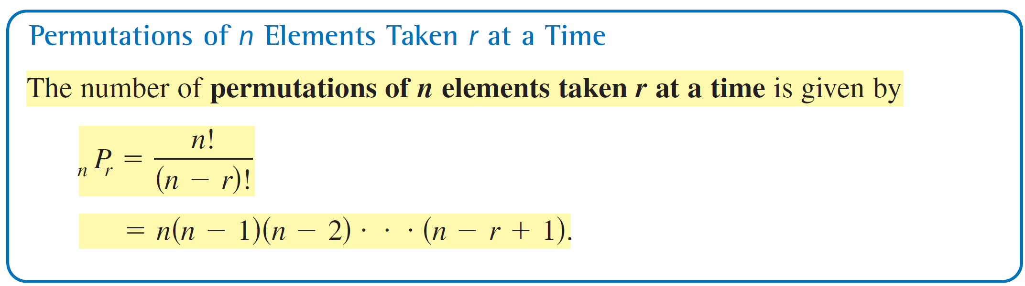
Permutations

Slide 8
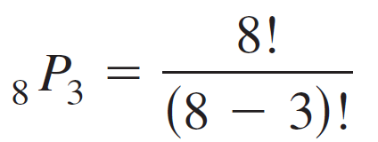
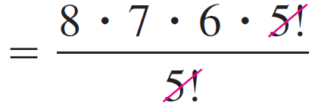
Permutations
Using this formula, find the number of permutations of eight horses taken three at a time is
= 336

Slide 9
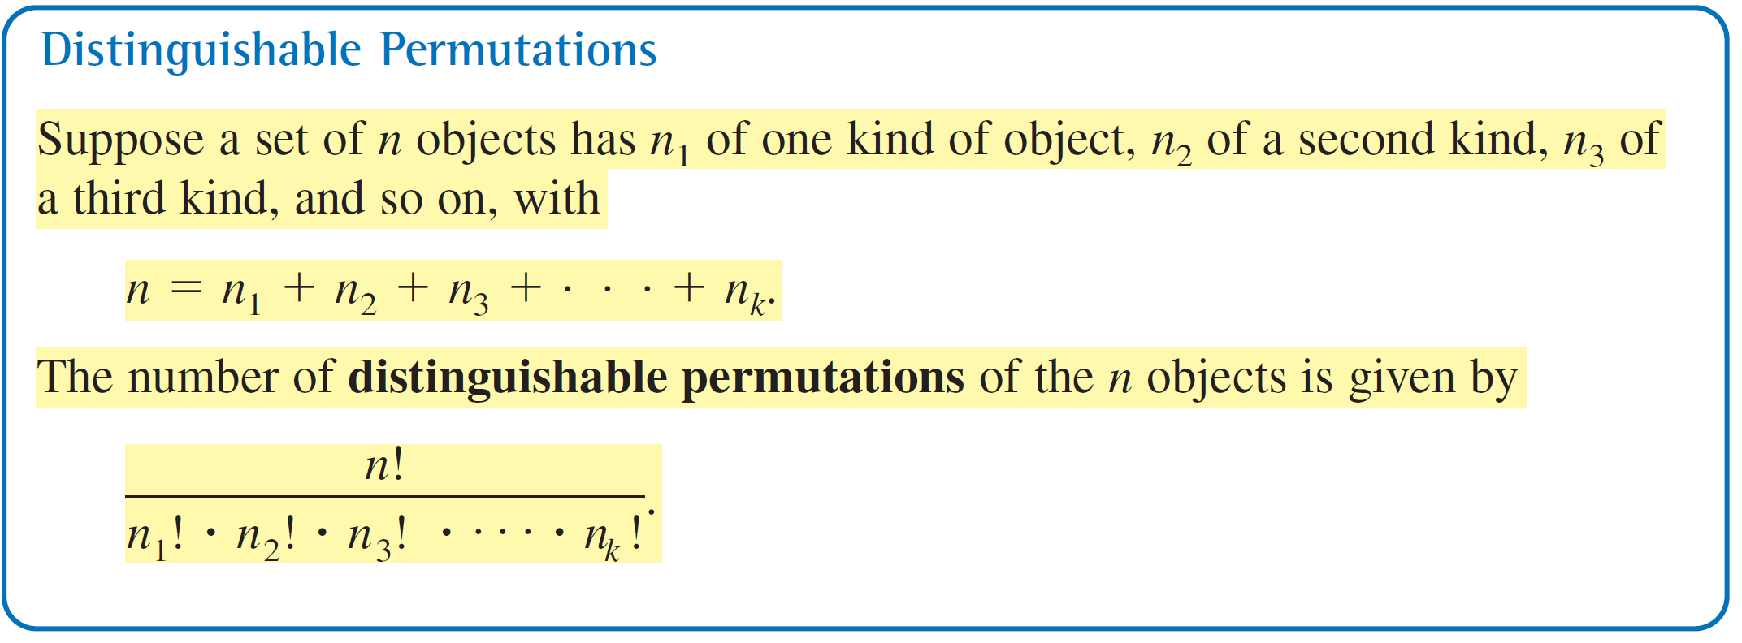
Permutations

Slide 10
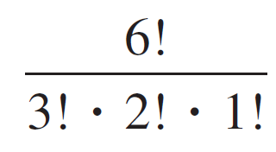
Example – Distinguishable Permutations
In how many distinguishable ways can the letters in BANANA be written?
Solution:
This word has six letters, of which three are A’s, two are N’s, and one is a B. So, the number of distinguishable ways in which the letters can be written is
= 60.

Slide 11
Example – Solution
cont’d
The 60 different distinguishable permutations are as follows.
AAABNN AAANBN AAANNB AABANN
AABNAN AABNNA AANABN AANANB
AANBAN AANBNA AANNAB AANNBA
ABAANN ABANAN ABANNA ABNAAN
ABNANA ABNNAA ANAABN ANAANB
ANABAN ANABNA ANANAB ANANBA
ANBAAN ANBANA ANBNAA ANNAAB

Slide 12
Example 7 – Solution
cont’d
ANNABA ANNBAA BAAANN BAANAN
BAANNA BANAAN BANANA BANNAA
BNAAAN BNAANA BNANAA BNNAAA
NAAABN NAAANB NAABAN NAABNA
NAANAB NAANBA NABAAN NABANA
NABNAA NANAAB NANABA NANBAA
NBAAAN NBAANA NBANAA NBNAAA
NNAAAB NNAABA NNABAA NNBAAA

Slide 13
Review Q
Find the number of arrangements of the letters of the word INDEPENDENCE. In how many of these arrangements,
Do the words start with P
Do all the vowels always occur together
Do the vowels never occur together
Do the words begin with I and end in P?

Slide 14
Review Ans
There are 12 letters of which N appears 3 times, E appears 4 times and D appears 2 times and the rest are all different. Therefore
The required number of arrangements
= 12!/(3! 4! 2!)
= 1663200

Slide 15
Review Ans [(1) Do the words start with P]
(1) Let us fix P at the extreme left , we then count the arrangements of the remaining 11 letters. Therefore ,
The required number of words starting with P are
= 11!/(3! 4! 2!) = 138600

Slide 16
Review Ans[(2) Do all the vowels always occur together]
(2)There are 5 vowels in the given word, which are 4 Es and 1 I. Since, they have to always occur together, we treat them as a single object EEEEI for the time being.
This single object together with 7 remaining objects will account for 8 objects. These 8 objects, in which there are 3Ns and 2Ds, can be rearranged in 8!/(3! 2!) ways.
Corresponding to each of these arrangements , the 5 vowels E,E,E,E,I can be rearranged in 5!/4! Ways.
Therefore, by multiplication principle the number of arrangements
= 8!/(3! 2!) x 5!/4! = 16800

Slide 17
Review Ans[(3) Do the vowels never occur together]
(3) The required number of arrangements = the total number of arrangements ( without any restriction ) – the number of arrangements where all the vowels occur together.
= 1663200 – 16800 = 1646400

Slide 18
Review Ans[(4) Do the words begin with I and end in P?]
Let us fix I and P at the extreme ends ( I at the left end) and P at the right end . We are left with 10 letters.
Hence, the required number of arrangements
= 10!/(3! 2! 4!) = 12600

Slide 19
Combinations

Slide 20
Combinations
When you count the number of possible permutations of a set of elements, order is important. Another method for selecting subsets of a larger set in which order is not important. Such subsets are called combinations of n elements taken r at a time. For instance, the combinations
{A, B, C} and {B, A, C} are equivalent because both sets contain the same three elements, and the order in which the elements are listed is not important.

Slide 21
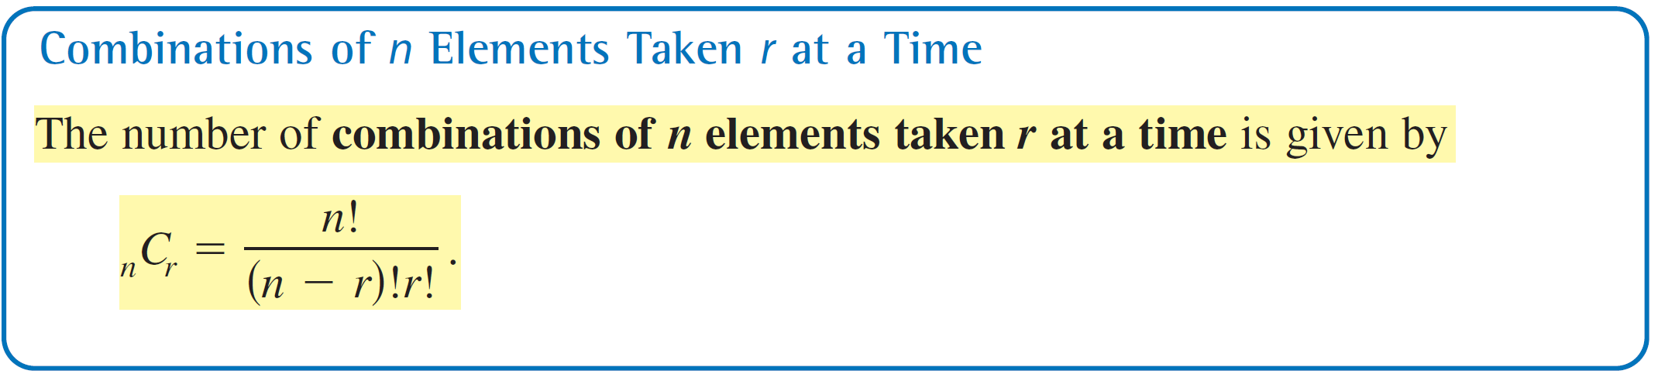
Combinations
So, you would count only one of the two sets. A common example of a combination is a card game in which the player is free to reorder the cards after they have been dealt.

Slide 22
Example – Combinations of n Elements Taken r at a Time
a. In how many different ways can three letters be chosen from the letters A, B, C, D, and E? (The order of the three letters is not important.)
b. A standard poker hand consists of five cards dealt from a deck of 52. How many different poker hands are possible? (After the cards are dealt, the player may reorder them, so order is not important.)

Slide 23
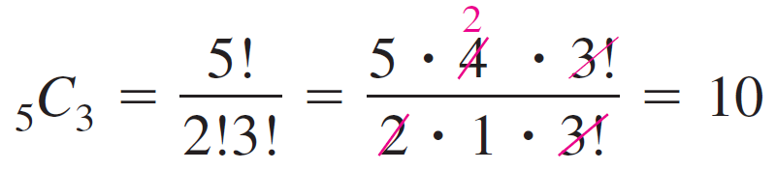
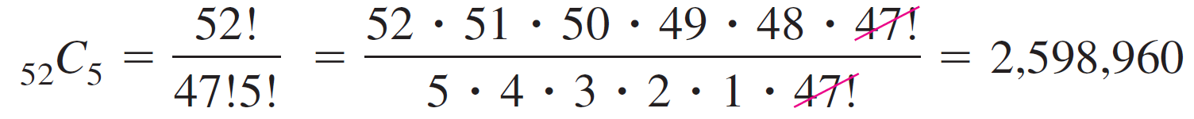
Example – Solution
a. You can find the number of different ways in which the letters can be chosen by using the formula for the number of combinations of five elements taken three at a time, as follows.
b. You can find the number of different poker hands by using the formula for the number of combinations of 52 elements taken five at a time, as follows.

Slide 24
Definition of a Random Variable
Random variable
A numerical value to each outcome of a particular experiment
-3
-2
-1
0
1
2
3

Slide 25
Two Types of Random Variables
A discrete random variable can assume a countable number of values.
Number of steps to the top of the Eiffel Tower*
A continuous random variable can assume any value along a given interval of a number line.
The time a tourist stays at the top
once s/he gets there
*Believe it or not, the answer ranges from 1,652 to 1,789. See Great Buildings

Slide 26


Two Types of Random Variables
Discrete random variables
Number of sales
Number of calls
Shares of stock
People in line
Mistakes per page
Continuous random variables
Length
Depth
Volume
Time
Weight

Slide 27
Probability Sample Questions
[Q1] There are 5 black 7 white balls. Assume we have drawn two balls randomly one by one without any replacement. What will be the probability that both balls are black?
[A.1] Detailed Solution:
Probability of first ball being black = 5/(5 + 7) = 5/12 .
Probability of drawing second ball black is = 4/(4 + 7) = 4 /11 .
Now overall probability of both balls being black = (5/12)×(4/11) = 20/132

Slide 28
Q2
[Q2]A bag contains 2 red, 3 green and 2 blue balls. Two balls are drawn at random. What is the
probability that none of the balls drawn is blue?
[A2] Total number of balls = (2 + 3 + 2) = 7.
Let S be the sample space.
Then, n(S) = Number of ways of drawing 2 balls out of 7 = 7C2 = 21
Let, E = event of drawing 2 balls, none of which is blue
n(E)= Number of ways of drawing 2 balls out of (2+3) i.e, 5 balls = 5C2 =10
Then, P(E) = 10/21

Slide 29
Q3
[Q3] What is the probability of getting a sum 9 from two throws of a dice?
[A3] In two throws of a dice, n(S) = (6 x 6) = 36.
Let E = event of getting a sum ={(3, 6), (4, 5), (5, 4), (6, 3)}.
Then, P(E ) = n(E ) / n(S) = 4/36= 1/9

Slide 30
Probability

Slide 31
Random Experiment
When a coin is tossed it may turn up a head or a tail, but we are not sure which one of these results will actually be obtained. Such experiments are called random experiments.

Slide 32
Random Experiment
An experiment is called random experiment if it satisfies the following two conditions:
It has more than one possible outcome
It is not possible to predict the outcome in advance.

Slide 33
Outcome
A possible result of a random experiment is called its outcome.
Consider the experiment of rolling a die. The outcome of this experiment are 1,2,3,4,5, or 6, if we are interested in the number of dots on the upper face of the dice.

Slide 34
Sample space
The set of outcomes S = {1,2,3,4,5,6} is called the sample space of the experiment.
The set of all possible outcomes of a random experiment is called the sample space associated with the experiment.
Consider the experiment of tossing a coin two times. An associated sample space is S = { HH, HT, TH, TT }

Slide 35
Sample point
Each element of the sample space is called the sample point.
Each outcome of the random experiment is called the sample point.

Slide 36
Event
Any subset E of a sample space S is called an event.
Consider the experiment of rolling a die.
Let A be the event ‘getting a prime number’
Let B be the event ‘getting a odd number’

Slide 37
Probability
Let S be a sample space and E be an event, such that n(S) = n and n(E) = m. If each outcome is equally likely, then it follows that
P(E)
= m/n
= (Number of outcomes favourable to E)/(Total possible outcomes)

Slide 38
Probability
If A and B are any two events, then
P(A or B) = P(A) + P(B) – P(A and B)
equivalently, P(A U B) = P(A) + P(B) – P(A ∩ B)

Slide 39
Probability
If A and B are mutually exclusive, then
P(A or B) = P(A) + P(B)
If A is any event, then
P(not A) = 1 – P(A)

Slide 40
Review Q
Q) A bag contains 9 discs of which 4 are read, 3 are blue, and 2 are yellow. The discs are similar in shape and size. A disc is drawn at random from the bag. Calculate the probability that it will be
Red
Yellow
Blue
Not blue
Either red or yellow

Slide 41
Review Ans
There are 9 discs in all so that total number of possible outcomes is 9.
The events A, B, C be defined as
A: ‘the disc drawn is red’
B: ‘the disc drawn is yellow’
C: ‘the disc drawn is blue’
The number of red discs = 4 i.e n(A) = 4
Hence P(A) = 4/9

Slide 42
Review Ans
ii) The number of yellow discs = 2 i.e n(B) = 2
Hence P(B) = 2/9
iii) The number of blue discs = 3 i.e n(C) = 3
Hence P(C) = 3/9 = 1/3
iv) The event ‘not blue’ is ‘not C’.
P(not C) = 1 – P( C ) = 1 – 1/3 = 2/3

Slide 43
Review Ans
v) The event ‘either red or yellow’ may be described by the set ‘A’ or ‘C’
Since A and C are mutually exclusive events,
P(A or C) = P( A U C) = P(A) + P(C)
= 4/9 + 1/3
= 7/9

Slide 44
Review Q
Q)A committee of two persons is selected from two men and two women. What is the probability that the committee will have (a) no man (b) one man (c ) two men ?

Slide 45
Review Ans
The total number of persons = 2 + 2 = 4. Out of these four persons, two can be selected in
⁴C₂ ways

Slide 46
Review Ans (a)
No men in the committee of two means there will be two women in the committee, Out of the two women , two can be selected in ²C₂ = 1 way
P(no man) = ²C₂/⁴C₂ = 1/6

Slide 47
Review Ans (b)
One man in the committee means that there is one woman. One man out of 2 can be selected in ²C₁ ways and one woman out of 2 can be selected in ²C₁ ways . Together they can be selected in ²C₁ X ²C₁ ways.
P(One man) = ² C₁ X ²C₁ /⁴C₂
= 2/3

Slide 48
Review Ans ( c )
Two men can be selected in ²C₂ = 1 way
P(Two men) = ²C₂/⁴C₂ = 1/6

Slide 49
Review Q
Q) Find the probability that when a hand of 7 cards is drawn from a well shuffled deck of 52 cards, it contains (i) all/4 kings (ii) 3 kings (iii) atleast 3 kings.
Total number of possible hands = ⁵²C₇

Slide 50
Review Ans ( i)
Number of hands with 4 kings = ⁴C₄ x ⁴⁸C₃ (other 3 cards must be chosen from the rest 48 cards)
P(a hand will have 4 kings) = ⁴C₄ x ⁴⁸C₃ / ⁵²C₇
₌ 1/7735

Slide 51
Review Ans (ii)
Number (hand with 3 kings and 4 non-king cards)
= ⁴C₃ x ⁴⁸C₄
P(3 kings) = ⁴C₃ x ⁴⁸C₄ / ⁵²C₇
₌ 9/1547

Slide 52
Review Ans (iii)
P( atleast 3 king) = P (3 kings or 4 kings)
= P (3 kings) + P (4 kings)
= 9/1547 + 1/7735
= 46/7735

Slide 53
Review Q
Q) In a relay race, there are 5 teams A,B,C,D and E
What is the probability that A,B and C finish first , second and third respectively
What is the probability that A,B and C are first three to finish ( in any order ) (Assume that all finishing orders are equally likely)

Slide 54
Review Ans
If we consider the sample space consisting of all finishing orders in the first three places,
We will have ⁵P₃ = 5!/(5 – 3)! = 60

Slide 55
Review Ans ( a)
A, B and C finish first, second and third respectively.
There is only one finishing order for this i.e ABC
P(A,B and C finish first, second and third respectively)
= 1/60

Slide 56
Review Ans (b)
A,B and C are the first three finishers. There will be 3! Arrangements for A,B and C.
P(A, B and C are first three to finish) = 3!/60
= 1/10

Slide 57
Conditional Probability

Slide 58
Conditional Probability
When there are two events from the same sample space, the occurrence of one of the
events affects the probability of the other event.

Slide 59
Example
Consider the experiment of tossing three fair coins. The sample space of the experiment is
S = {HHH,HHT,HTH,THH,HTT,THT,TTH,TTT}
Let E be the event ‘at least two heads appear’
Let F be the event ‘first coin shows tail’
E = {HHH,HHT,HTH,THH} ; P(E ) = ½
F = {THH,THT,TTH,TTT} ; P(F ) = ½
E∩F = {THH} ; P(E∩F) = 1/8

Slide 60
Example
If event F has occurred , what is the probability of occurrence of E?
The occurrence of event F reduces the sample space from the set S to its subset F for the event E
F = {THH,THT,TTH,TTT}
Thus probability of E considering F as the sample space = ¼ OR
probability of E given F has occurred = ¼
P(E|F) = conditional probability of E given that F has already occurred = ¼

Slide 61
Example
Note that the elements of F which favour the event E are the common elements of E and F,
i.e. the sample points of E∩F
P(E|F) = Number of sample points in E∩F
Number of sample points in F
= n (E∩F)/n(F) = P (E∩F)/P(F)
{Dividing the numerator n denominator by n(S)}

Slide 62
Conditional Probability
The conditional probability of an event E,
Given the occurrence of an event F (event F has already occurred) is given by
P(E|F) = P(E ∩ F)/ P(F) , P(F) ≠ 0
Q) If P(A) = 7/13, P(B) = 9/13 and P(A ∩ B)= 4/13
Evaluate P(A|B)
A) 4/9

Slide 63
Example
Q) A family has two children. What is the probability that both the children are boys, given that at least one of them is a boy ?

Slide 64
Example – Ans
Let b stand for boy and g for girl. The sample space of the experiment is
S = {(b,b),(g,b),(b,g),(g,g)}
E = ‘both the children are boys’={(b,b)}
F = ‘Atleast one of the child is a boy’={(b,b),(g,b),(b,g)}
E ∩ F = {(b,b)}
P(F) = ¾
P(E ∩ F ) = ¼
P(E | F) = P(E ∩ F ) / P(F) = 1/3

Slide 65
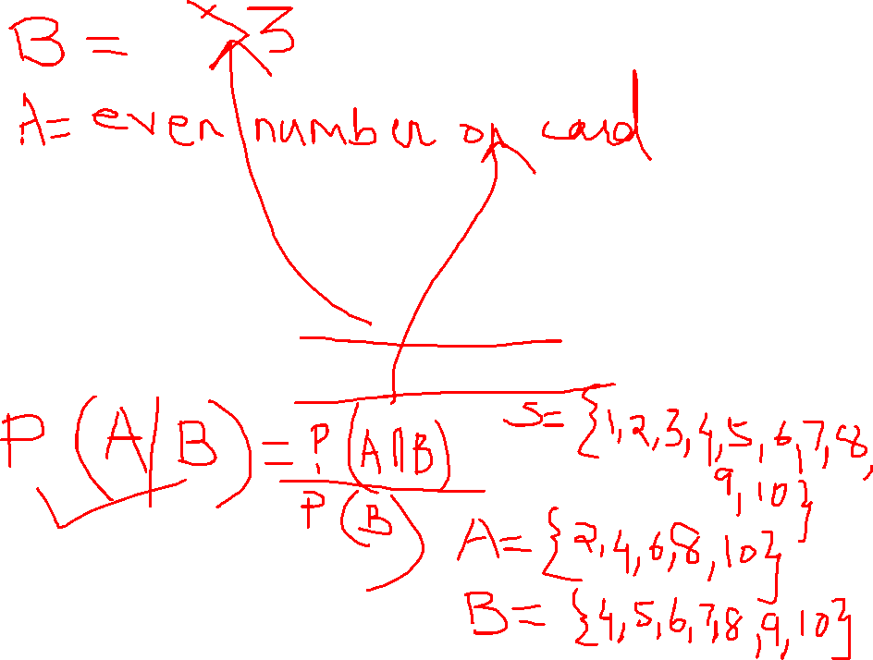
Review Q
Q) Ten cards numbered 1 to 10 are placed in a box, mixed up thoroughly and then one card is drawn randomly. If it is known that the number on the drawn card is more than 3, what is the probability that it is an even number ?

Slide 66
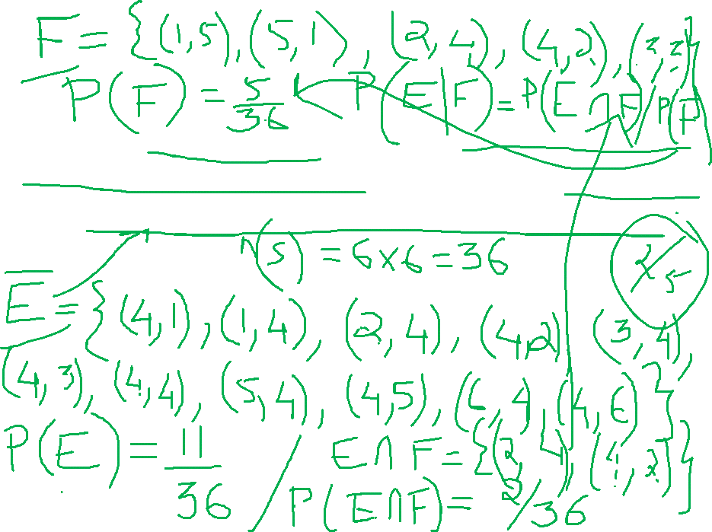
Review Q
Q) A dice is thrown twice and the sum of the numbers appearing is observed to be 6. What is the conditional probability that the number 4 has appeared at least once ?

Slide 67

Multiplication rule of probability
P(E|F) = P(E ∩ F)/ P(F) , P(F) ≠ 0
P(E ∩ F) = P(F) * P(E|F) (A)
P(F|E) = P(F ∩ E)/ P(E) , P(E) ≠ 0
P(F|E) = P(E ∩ F)/ P(E) { since (E ∩ F) = (F ∩ E) }
Thus, P(E ∩ F) = P(E) * P(F|E) (B)
P(E ∩ F) = P(E) * P(F|E) {P(F) ≠ 0 ; P(E) ≠ 0}
= P(F) * P(E|F)

Slide 68
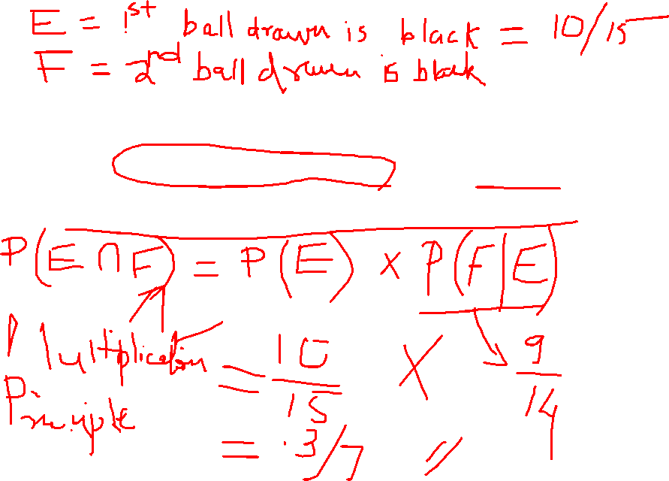
Example
Q)An urn contains 10 black and 5 white balls. Two balls are drawn from the urn one after the other without replacement. What is the probability that both drawn balls are black?

Slide 69

Example
Q)There are 11 tickets in a box bearing numbers 1 to 11. Three tickets are drawn one after the other without replacement. Find the probability that they are drawn in the order bearing
even, odd, even number
Odd, odd, even number

Slide 70
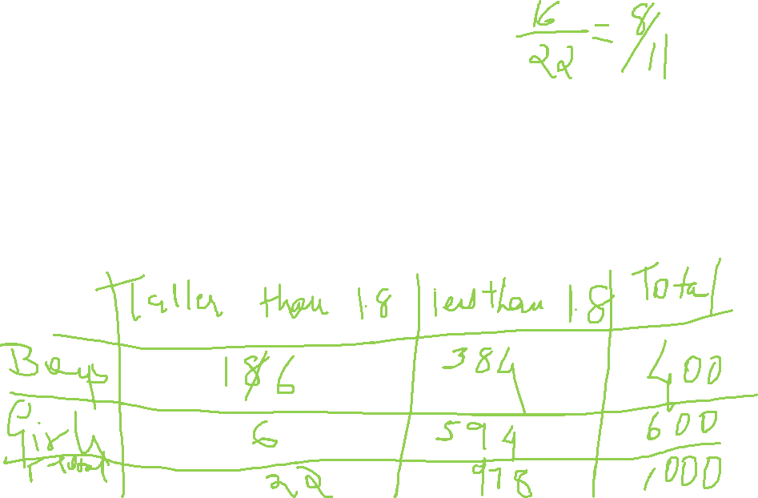
Example
Q) In a certain college 4% of the boys and 1% of the girls are taller than 1.8 mts, furthermore 60% of the students are girls. If a student selected at random is taller than 1.8 mts, what is the probability that the student was a boy ?

Slide 71
Bayes Theorem

Slide 72
Bayes theorem
If E₁, E₂, E₃ ….. ,En are n non-empty events which constitute a partition of sample space S, i.e. E₁, E₂, E₃ ….. ,En are pairwise disjoint and
E₁UE₂ ….UEn = S and
A is any event of nonzero probability, then
P(EiIA) = P(A ∩Ei)/P(A)
= P(Ei)P(AIEi)/P(A) (by multiplication rule of probability)
n
= P(Ei)P(AIEi)/∑ P(Ej)P(AIEj ) (by theorem of total probability) j=1

Slide 73
Example Problem1
Q1) Bag I contains 3 red and 4 blue balls while another Bag II contains 5 red and 6 blue balls. One ball is drawn at random from one of the bags and it is found to be red. Find the probability that it was drawn from Bag II.
A1) Let E₁ be the event of choosing from Bag I.
Let E₂ be the event of choosing from Bag II.
Let A be the event of drawing a red ball.
P(E₁) = P(E₂) = ½ ; P(AIE₁) = 3/7 ; P(AIE₂) = 5/11
P(E₂IA) = P(E₂) P(AIE₂) = 35/68
P(E₁) P(AIE₁) + P(E₂) P(AIE₂)

Slide 74
Example Problem2
Q2)Given three identical boxes I, II, III, each containing two coins. In box I, both coins are gold coins.
In box II, both are silver coins and in the box III, there is one gold and one silver coin.
A person chooses a box at random and takes out a coin. If the coin is of gold, what is the probability that the other coin in the box is also of gold?
A2) P(E₁) = P(E₂) = P(E₃) = 1/3
Find P(AIE₁),P(AIE₂),P(AIE₃)
Using Bayes Theorem, find P(E₁IA)

Slide 75
Example Problem3
Q3)In a factory which manufactures bolts, machines A,B & C manufacture respectively 25%,35% and 40% of the bolts. Of their outputs, 5,4 & 2 percent are respectively defective bolts. A bolt is drawn at random
from the product and is found to be defective. What is the probability that it is manufactured by the machine B ?
A3)Find P(B₁),P(B₂),P(B₃),P(EIB₁), P(EIB₂), P(EIB₃)
Using Bayes Theorem find P(B₂IE)

Slide 76
ExampleProblem4
Q4)A man is known to speak truth 3 out of 4 times. He throws a die and reports that it is a six. Find the probability that it is actually a six.
A4)Find P(S₁),P(S₂),P(EIS₁),P(EIS₂)
Using Bayes Theorem, find P(S₁IE)

